Slide 1



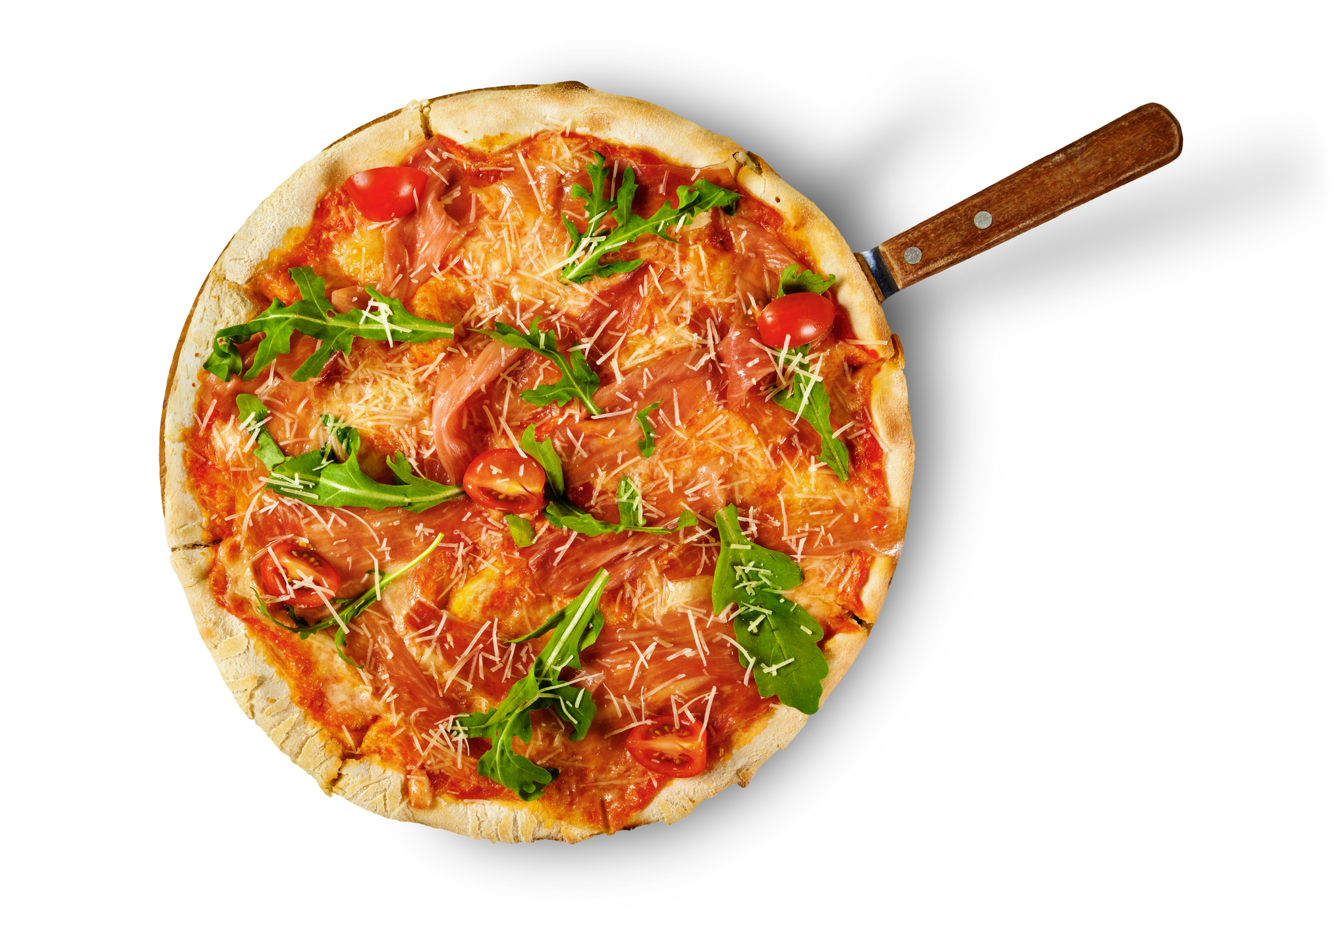

PRESENTED BY FRANCISCO FERREIRA
Pizza Sales
Dashboard Analysis

Slide 2
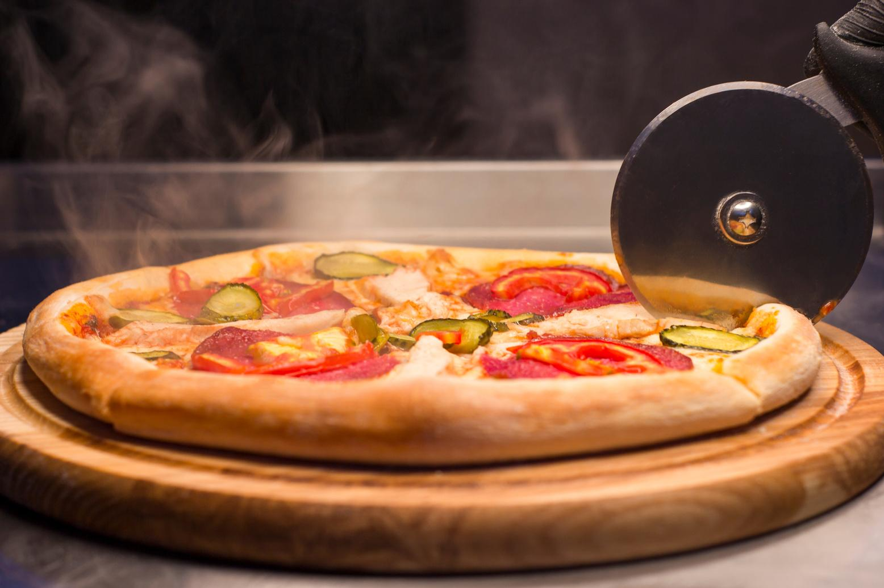
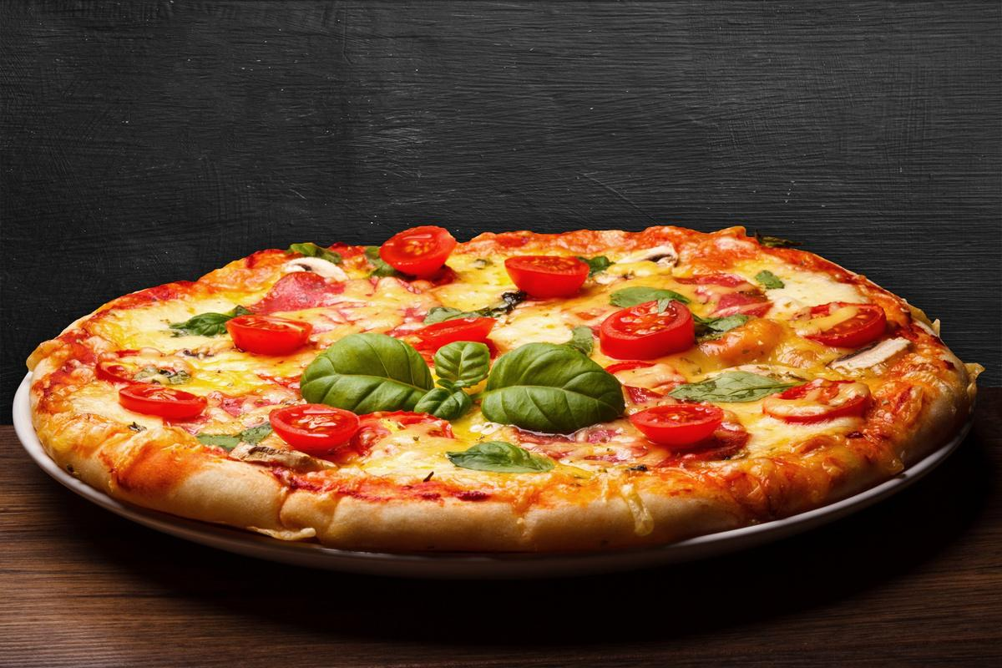




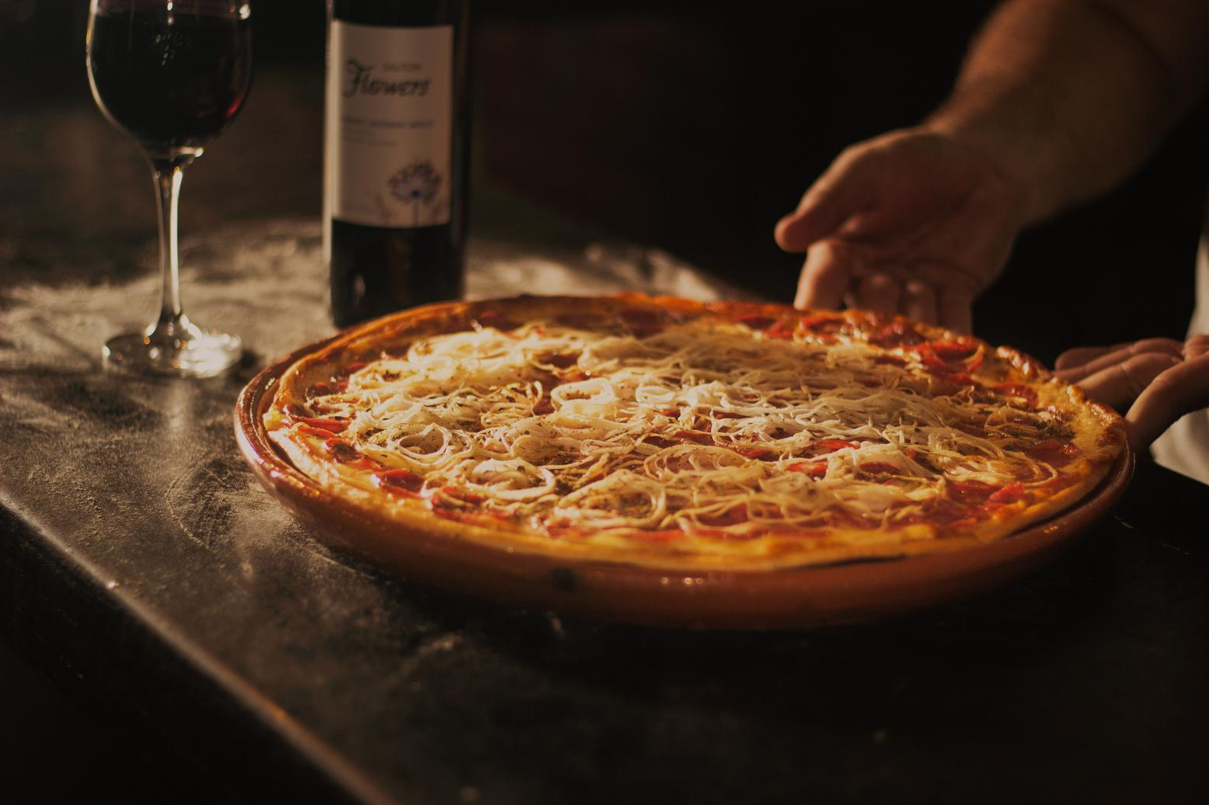
Executive Summary
This sales dashboard provides a comprehensive view of the pizzeria’s performance, helping identify peak ordering times, popular pizza categories and sizes, and top- and bottom-performing menu items.
With over $817,000 in revenue and more than 21,000 orders, the data reveals strong weekend sales and consistent demand for large-sized, classic pizzas. These insights enable better decisions around promotions, menu optimization, and staffing.

Slide 3
Summary Table
Metric | Insight
Total Revenue | $817,860 – driven by strong weekend and midday sales
Avg. Order Value | $38.31 – consistent across the week
Total Orders | 21,350 – most orders placed on Friday and Saturday
Total Pizzas Sold | 49,574 – average of 2.32 pizzas per order
Top Pizza Category | Classic – 14,888 units sold, most popular across all categories
Top Pizza Size | Large – 45.89% of sales, highest contributor to revenue
Best Sellers | Classic Deluxe, Chicken, Barbecue Chicken – top revenue generators
Worst Sellers | Brie Carre, Mediterranean, Calabrese – lowest sales and revenue

Slide 4
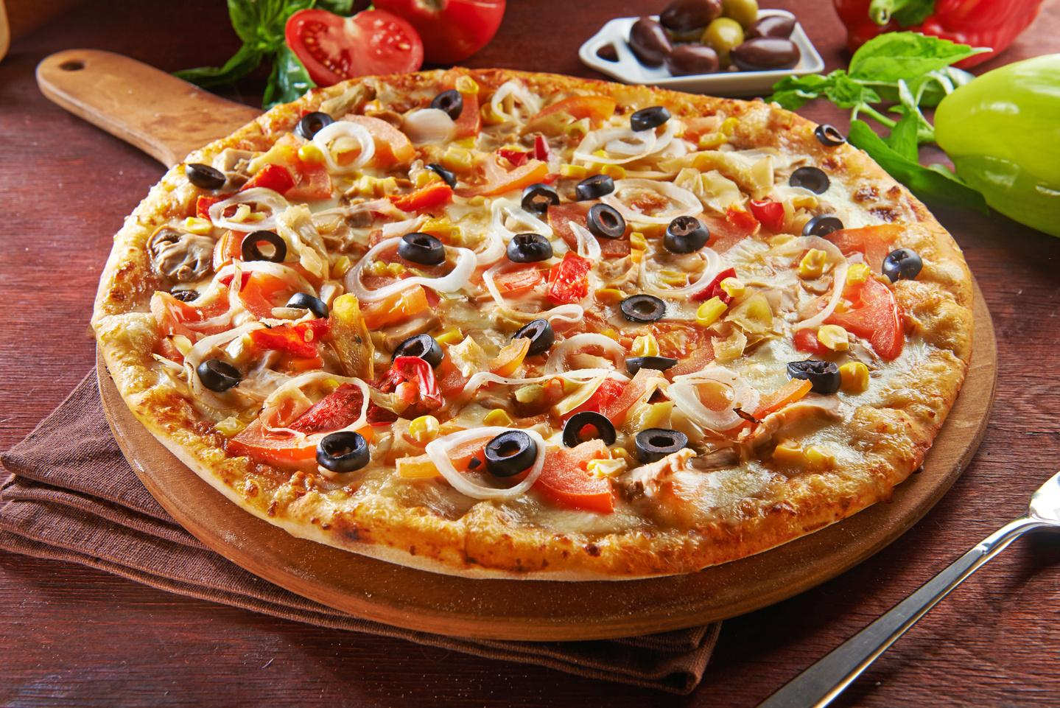
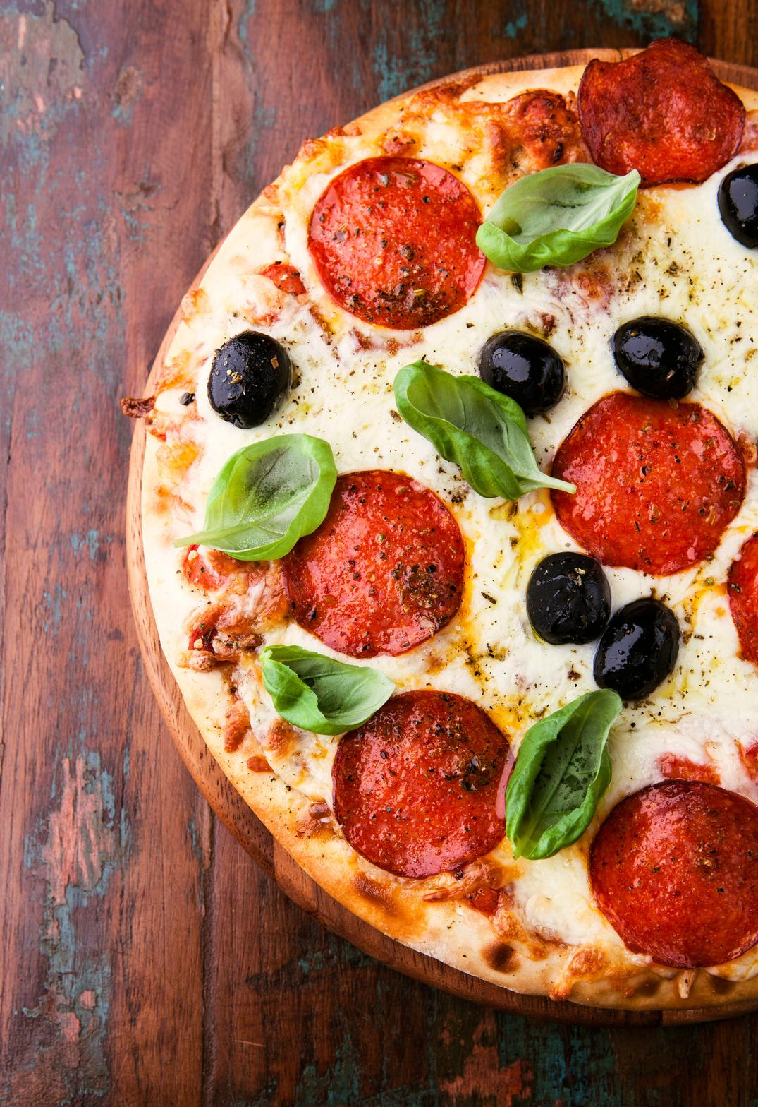
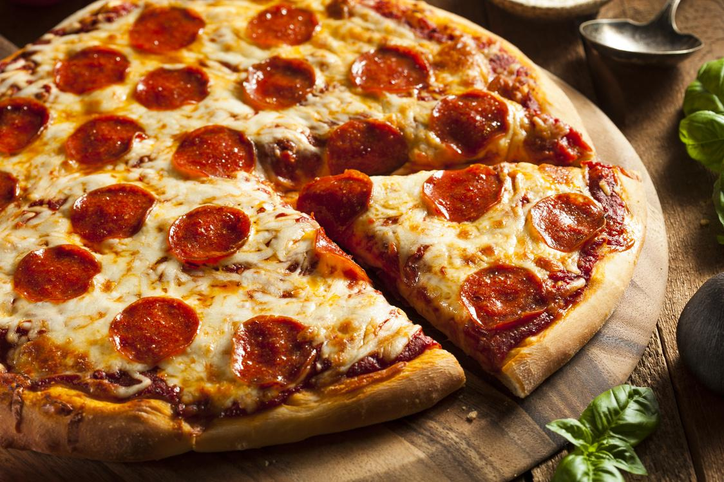
Key Trends
Peak Sales Days: Friday and Saturday show the highest volume, confirming strong weekend demand.
Peak Sales Hours: Most orders are placed around midday (12–2 PM) and evening (5–8 PM), informing optimal staffing windows.
Category Demand: Classic and Chicken pizzas lead in sales and revenue.
Size Preferences: Large pizzas dominate both in quantity sold and sales value.
Order Behavior: Customers typically order more than 2 pizzas per order, suggesting frequent group or family purchases.

Slide 5





General Recommendations
Optimize Staff Scheduling: Allocate more staff during Friday/Saturday lunch and dinner hours.
Enhance Promotions: Focus on best sellers for combo deals and spotlight underperformers for revamp or removal.
Drive Upsells: Create bundle deals (large pizza + drink/side) to increase AOV (Average Order Value).
Inventory Efficiency: Stock ingredients based on top-performing categories and sizes to reduce waste.
Seasonal Campaigns: Use the observed peaks to launch time-limited offers during high-traffic periods.

Slide 6
Stakeholder Recommendations
Stakeholder | Actionable Suggestion
Store Managers | Use hourly data to staff peak times; track low performers to reduce prep waste.
Marketing Team | Promote best sellers in social and loyalty programs; test offers for slow-selling pizzas.
Operations | Adjust supply chain forecasts based on category/size trends.
Finance | Monitor AOV and margin trends to fine-tune pricing and promotions.

Slide 7
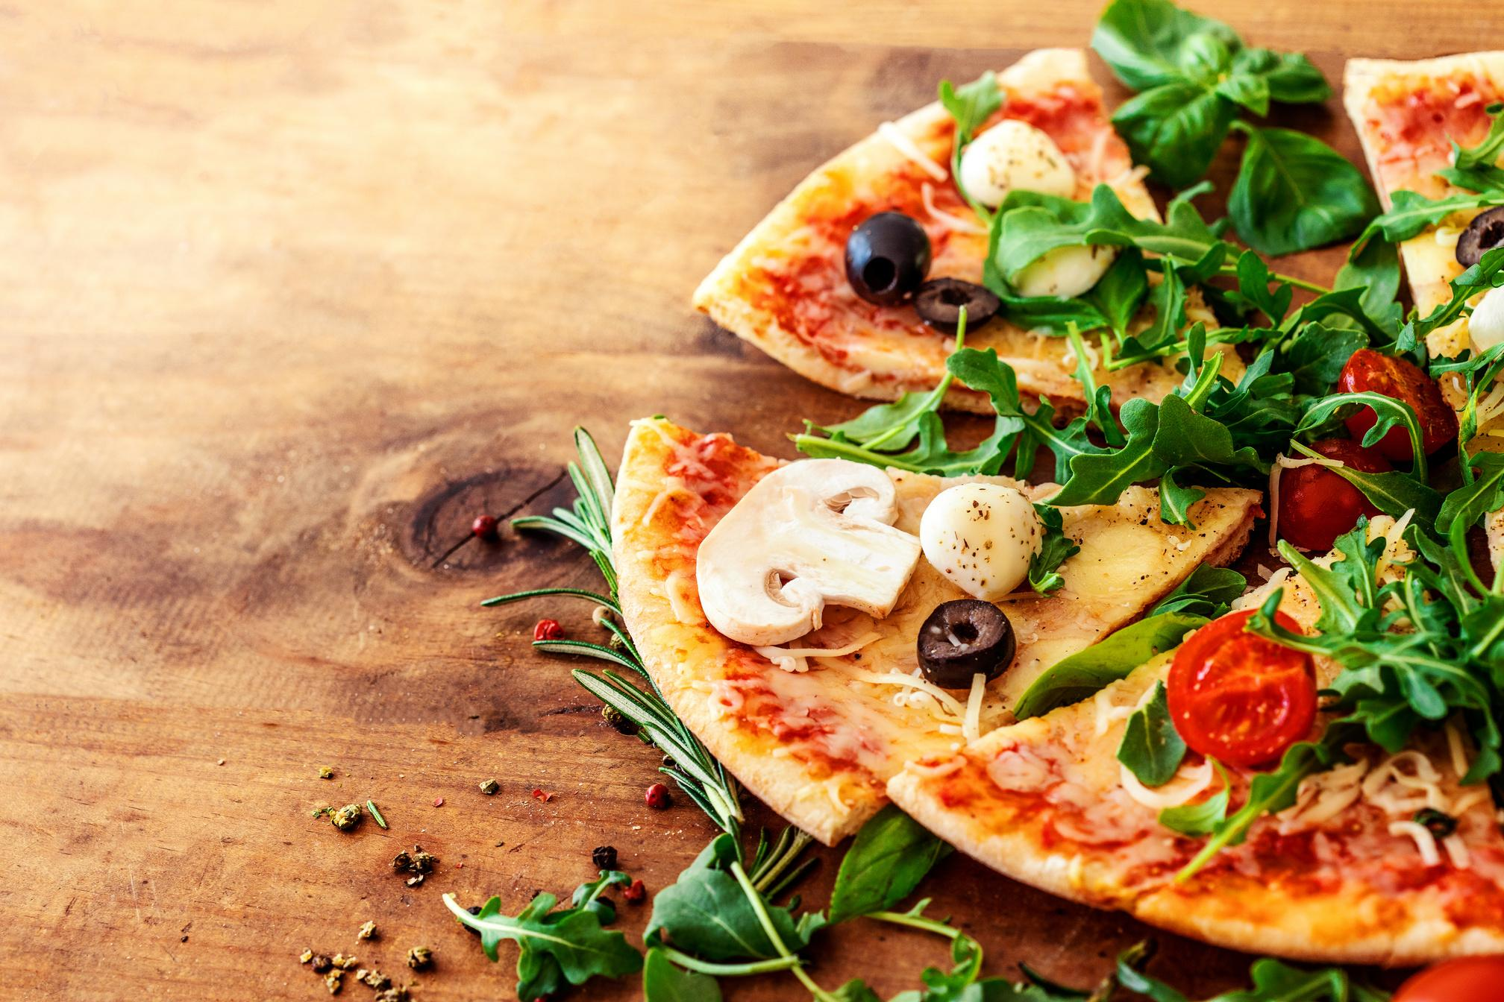

Limitations of the Data
Time Range: Data appears to cover a single year, which may limit seasonal analysis or year-over-year comparisons.
Customer Demographics: No demographic or behavioral segmentation (e.g., new vs. repeat customers).
Sales Channel Breakdown: No clear separation of online vs. in-store orders.
External Factors: Influences such as weather, events, or marketing campaigns aren’t reflected.

Slide 8

PRESENTED BY FRANCISCO FERREIRA
Thank
You!
EMAIL
fsemedo2001@hotmail.com
PHONE
+351 962 697 540
WEBSITE
portfolio

